Slide 1
Mobile Application Development
Lecture 6

Slide 2
Forms in Angular
A large category of frontend applications are very form-intensive, especially in the case of enterprise development. Many of these applications are basically just huge forms, spanning multiple tabs and dialogs and with non-trivial validation business logic.
There are two types of forms in Angular. Template Driven Forms and Reactive / Model Driven Forms.
Reactive Forms are arguably the best thing about Angular ( biased opinion ☺ )

Slide 3
Template Driven vs Reactive Forms
In a template-driven approach, most of the logic is driven from the template, whereas in reactive-driven approach, the logic resides mainly in the component or typescript code.
Template Driven forms involve writing less code however it can get complicated very quickly.
Template Driven forms get complicated very quickly and are very difficult to handle when the forms get large.
Reactive forms or Model-driven forms are more robust, scalable, reusable, and testable.

Slide 4
Template Driven vs Reactive Forms
Validations especially custom validations in Template Driven forms are very hard whereas they are a breeze to work with in Reactive Forms.
Working on large Forms is very easier in Reactive Forms compared to Template Driven.
Even React.js doesnot provide such easy form manipulation as Angular. With React.js, you would need to include a library like Formik however Angular offers such forms handling out of the box through Reactive Forms.

Slide 5
“You’ll stop worrying what others think about you when you realize how seldom they do.” ~ David Foster Wallace

Slide 6
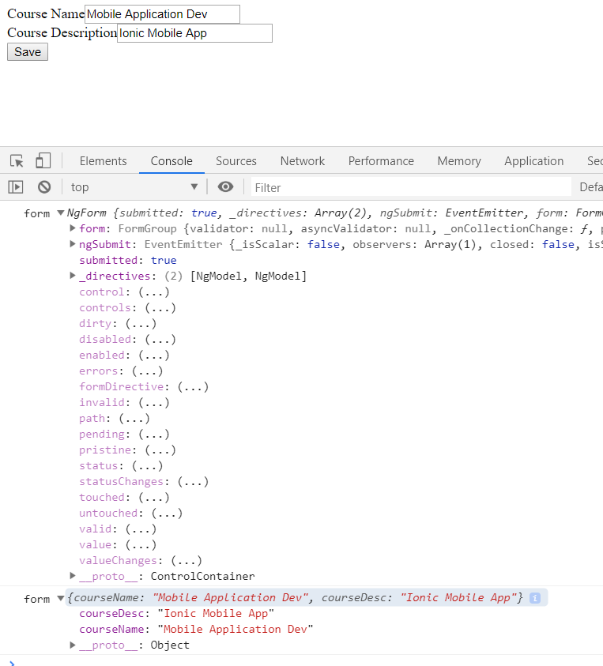
Template Driven Forms

Slide 7
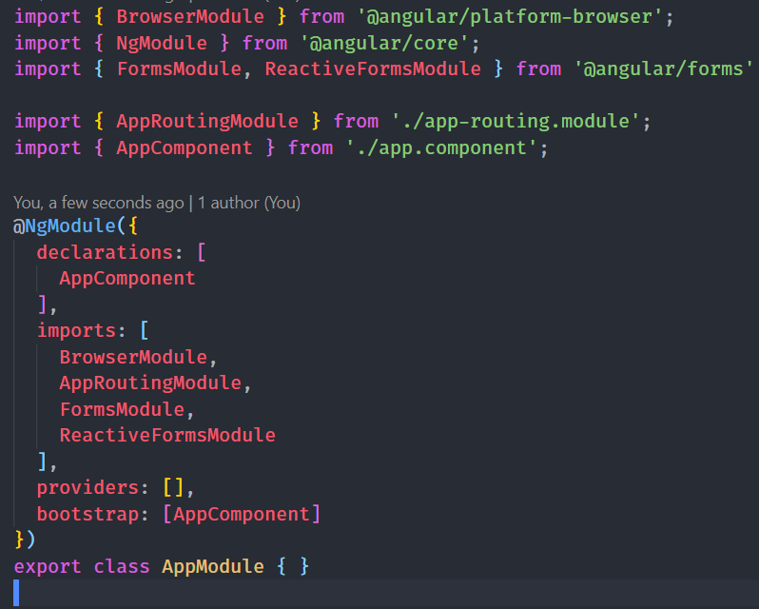
Reactive Forms
In the model-driven form, we need to import a ReactiveFormsModule from @angular/forms and use the same in the imports array.

Slide 8
Reactive Forms
In the app.component.ts file, we need to import the few modules for the model-driven form. For example, import { FormGroup, FormBuilder, Validators } from ‘@angular/forms’.

Slide 9
Reactive Forms
We inject formbuilder instance in constructor.
we initialize the form on ngOnInit.
all the form logic resides inside .TS / component file

Slide 10
Reactive Forms
HTML Code. Here we add [formGroup] and only formControlName to each fields. That’s it.

Slide 11
Reactive Forms
Example of custom validations made easy using Reactive Forms
Notes:
[ngClass]="{
error: formSubmit && loginForm.controls['email'].invalid
}"

